Slide 1

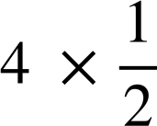
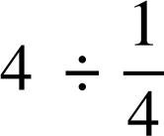
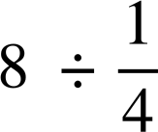
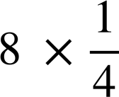

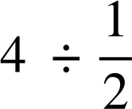

Solving simple linear equations with a multiplicative step
Task A: Multiplicative steps using representations
Match up the bar models with the calculations which will find the solution. There may be more than one calculation for each diagram.
a)
x
x
d)
4
4
4 × 2
4 ÷ 2
b)
x
x
x
x
8
e)
c)
8
8 ÷ 4
4
4 × 4
8 × 4
2) Use these bar models to find the value of x
a)
x
x
x
x
x
d)
x
x
x
15
5
b)
15
e)
18
x
x
x
x
x
x
x
c)
30
f)
x
x
x
x
x
x
x
x
x
x
10

Slide 2


Solving simple linear equations with a multiplicative step
Task B: Writing solutions algebraically
Solve each equation.
a)
f)
2x | = | 18
−8x | = | 18
b)
 | = | 13
6x | = | 30
g)
c)
 | = | −10
5x | = | 9
h)
d)
i)
21x | = | −21
−1.4x | = | 4.2
e)
−2x | = | −12
Mathematics in Education and Industry
v2.3

